Slide 1
Beast from the East
…..
…….

Slide 2
Global warming
By Muhd Syamil bin Dzulkaftah

Slide 3
Summary
What is global warming
What causes global warming
What are the effects of global warming
How to prevent global warming
Conclusion

Slide 4
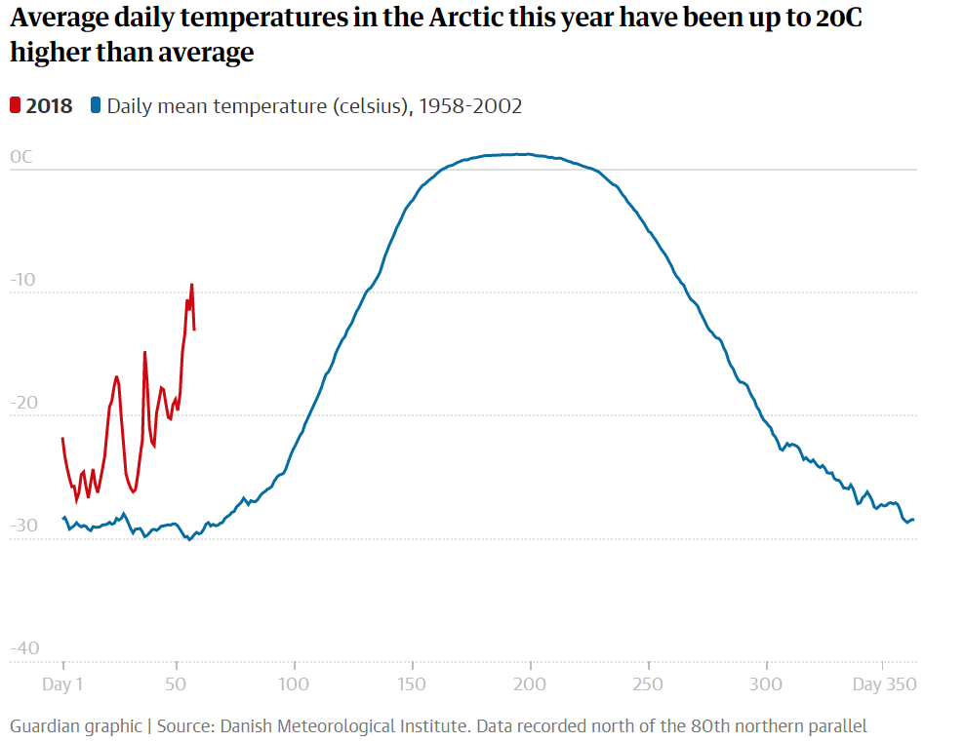
What is global warming?

Slide 5
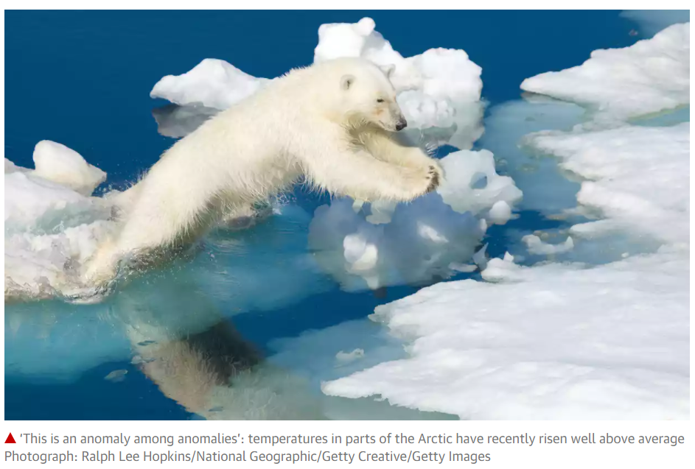
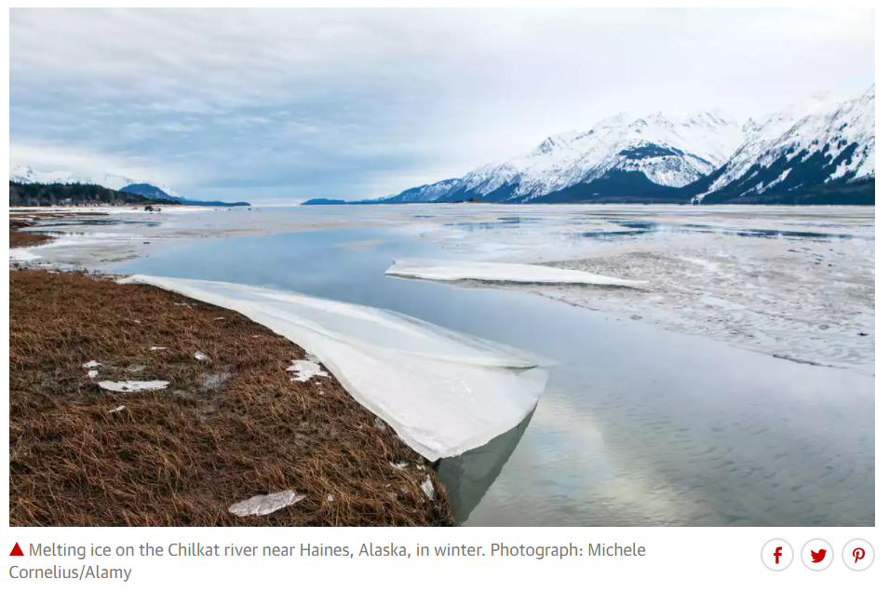
Anomaly : something different, abnormal, peculiar or not easily classified

Slide 6
What causes global warming?
Enhanced greenhouse effect
Deforestation

Slide 7
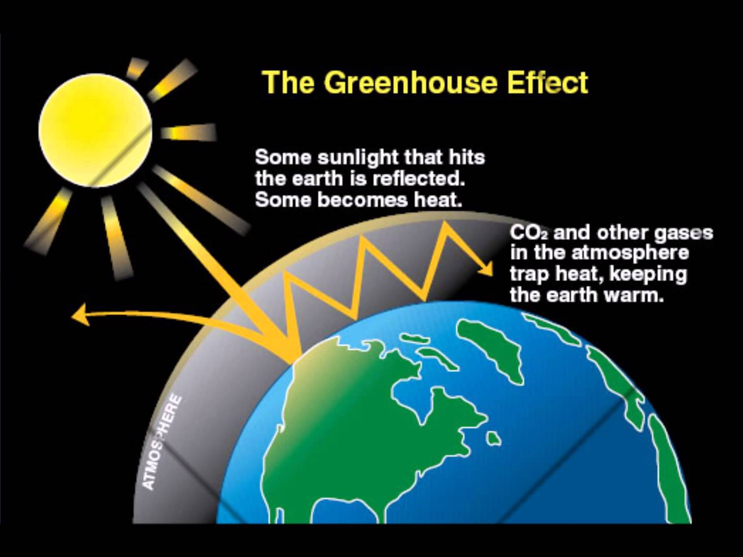
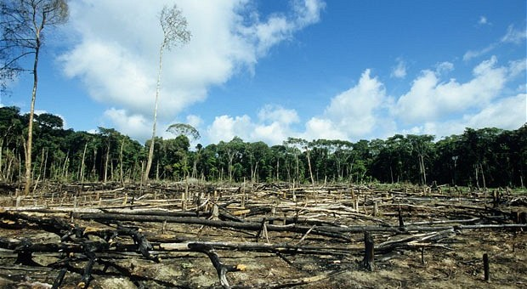
Greenhouse gas emissions and the enhanced greenhouse effect
Deforestation

Slide 8

What are the effects of global warming?
Desertification
Increase melting of snow and ice
Sea level rise
Stronger hurricanes and cyclones

Slide 9
Is global warming too big of a problem for me to help tackle?

Slide 10

How to prevent global warming?
Energy Star Label
Highest gas mileage and lowest emission
Public transportation or carpool

Slide 11

Thank you for listening :)

